Slide 1
Griff Volker Final Project
GES 675 - Professor Yang

Slide 2
Final Project
Map shows ports in the United States
Ports are critical infrastructure
Infrastructure and planning are areas that interest me

Slide 3
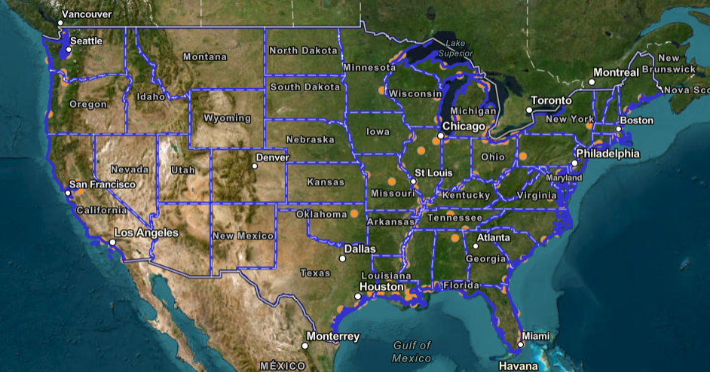

Slide 4
Data
Data was added to the map from by adding it as a geojson layer and fetching it from my local computer
The source of the ports layer was fetched from ArcGIS online here
Project includes state boundary layers for layer query
By selecting the states layer, we can find the ports within the state
State layer was fetched from ArcGIS online found here

Slide 5
General Principles
Having a title for the map along with a paragraph description in the webpage using html
Using the API to reference the ‘require’ and function fields so code will work
Defining a map with the ‘layers’ referencing the layer names of the data
Defining a mapview
Adding my api key

Slide 6
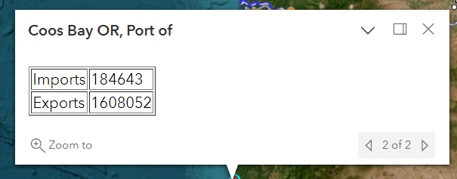
Popup Windows
Pop up windows were added when the data is selected on the map
Code was used to call the ‘popup template’ to include attribute fields in the title and content
Adding relevant fields from geojson layer
Also works with states
Docking the popup makes it easier to see map

Slide 7
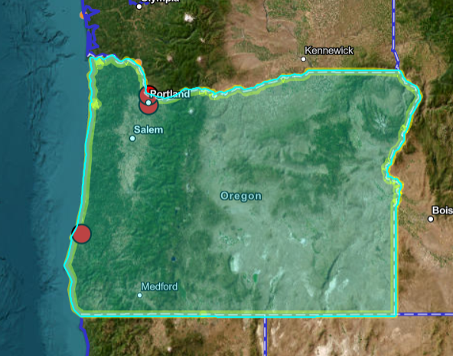
Using State Layer to Highlight Ports
Function was added so that when selecting a state, ports are highlighted
Had to make a new graphic and define it on click of state
Setting the symbology so states are easily visible
Display the names of the ports outside of the map in a popup

Slide 8

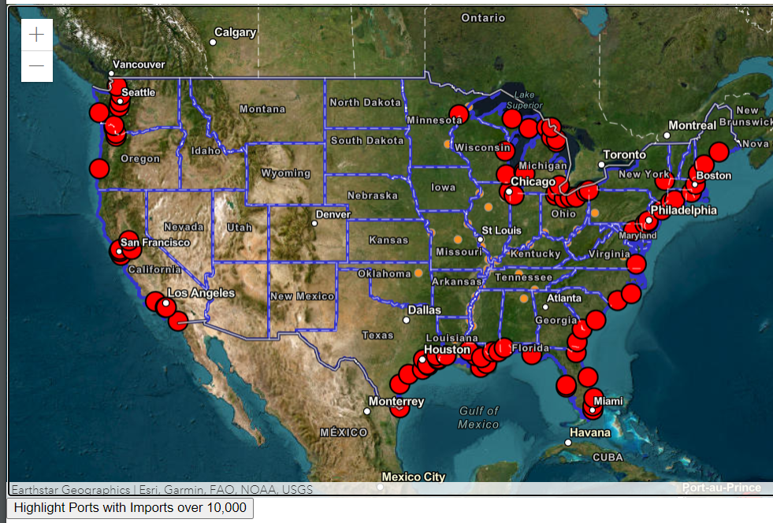
Querying Ports Data
Querying the layers
Based on attribute data of ports
For my project, I queried ports with over 10,000 imports
Ports were highlighted on the map after button is clicked

Slide 9
Challenges and Insights
Challenges
Querying and layer interactivity
Using the Esri API to use functions we have not covered in class
Defining variables and calling them back
Insights
Using a geojson layer was best approach to add data
Finding the right data with attributes to query and display was important

